Slide 1
FILM HISTORY
THE EARLY DAYS (1899-1900)

Slide 2
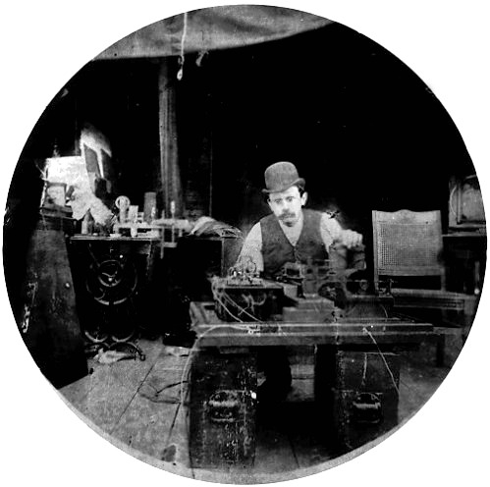
1890 THE FIRST VIDEO CAMERA IS INVENTED
Notes:
This was called the Kinetograph, it was bulky, and actors came to it, as opposed to the other way around. It used sprocketed film, and only had one lens. It also used an electric motor (reminder of Edison trying to push low voltage electricity)

Slide 3
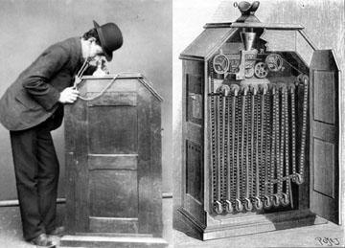
MOVIES WERE SHOWN ON A KINETOSCOPE
Notes:
These could only be shown to one person at a time, and were coin operated.

Slide 4
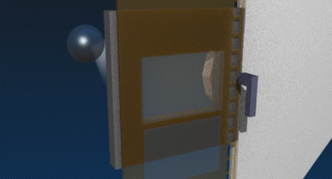

HOW A SHUTTER WORKS

Slide 5

STUPID CAT TRICKS PREDATING THE INTERNET BY 100 YEARS.
Notes:
Boxing cats 1894 Edison kinetograph. Proof of stupid cat tricks predating the internet by 100 years.

Slide 6
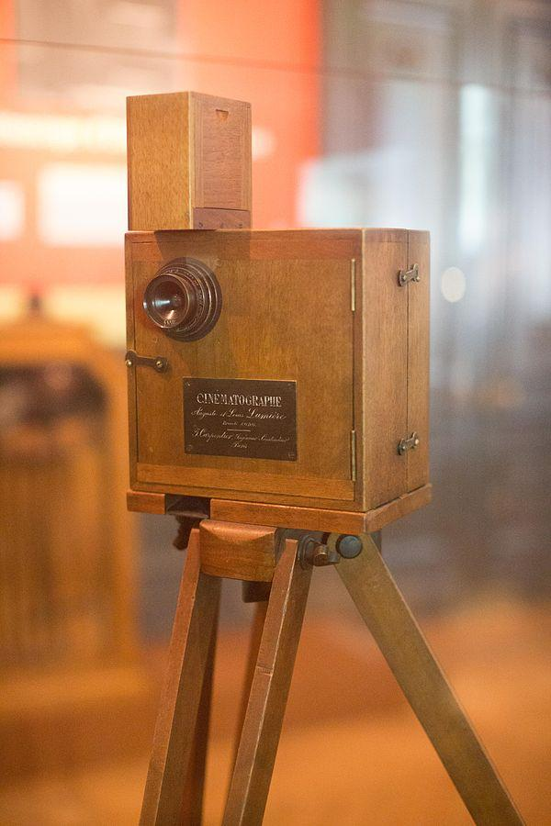
CINEMATOGRAPH IS CAMERA AND PROJECTOR IN ONE
Notes:
Mention the French American animosity for one another. Cinematograph translates to "writing in motion"
16 pounds. Edison later tried to sue another american company saying he invented the movie camera, but it was decided that he actually only invented the sprocket system to advance film.

Slide 7
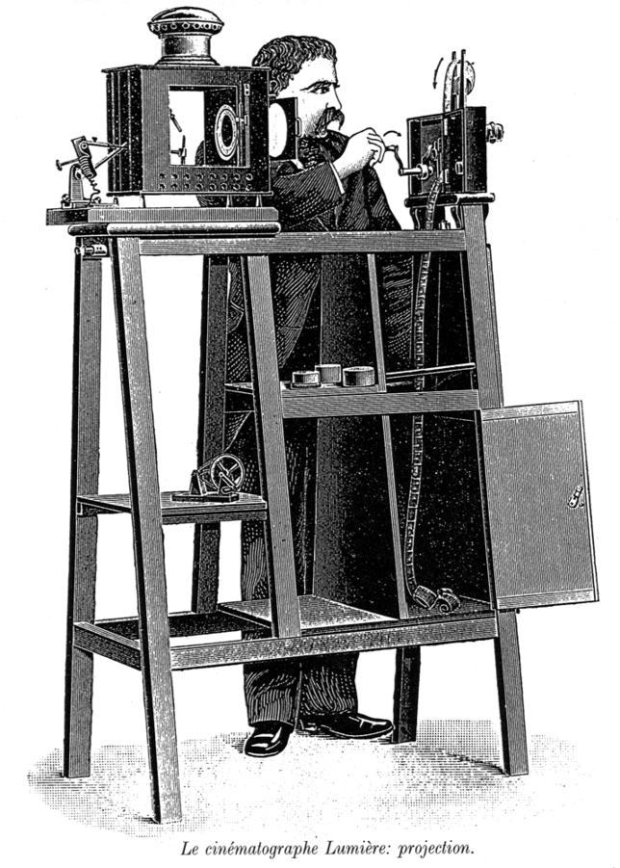
PROJECTOR
Notes:
Water in a flask was used to prevent the focused light from starting the film on fire.

Slide 8
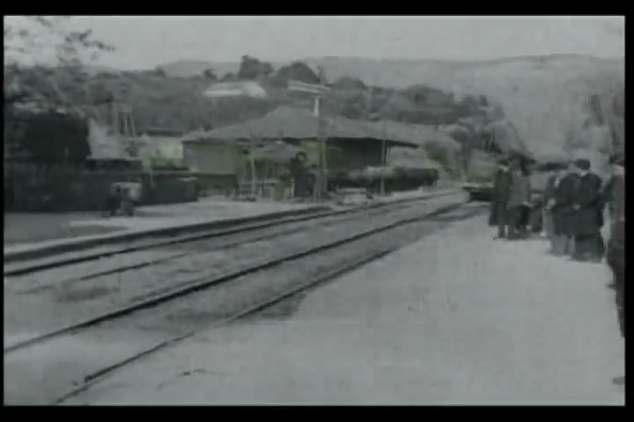
ARRIVAL OF A TRAIN AT LA CIOTAT
Notes:
1895 Lumiere brothers

Slide 9
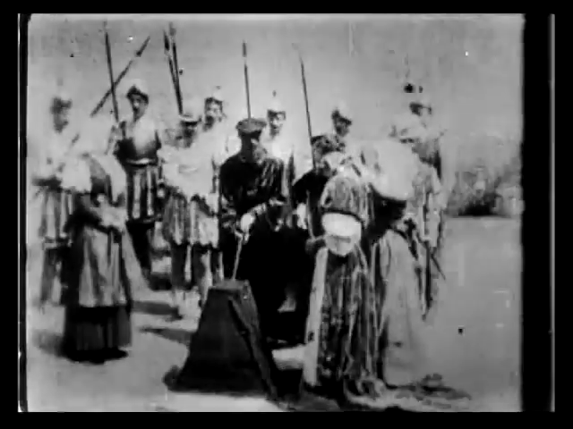
ACTUALITIES
Most of the films shown and recorded over this decade were “actualities” which were essentially just recordings of day to day events.
One exception would be the film “The Execution; Mary Queen of Scots”
This would be a controversial film, as would many, and thus begins the never ending debate over film rating and censorship.

